Slide 1
Data Analytics Associate Final Project Presentation
Name: Angeline. J
Enrollment No: EBEON0322573450
Batch: 2021-7234

Slide 2
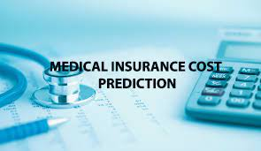
lMedival insurance cost Prediction

Slide 3
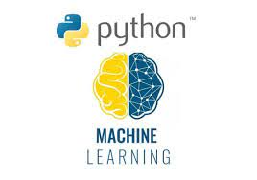
Python is a widely used general-purpose, high-level programming language.
Python is a programming language that lets you work quickly and integrate systems more efficiently.

Slide 4
Application Of Python Language
Web Development
Machine Learning
Data Analysis
Scripting
Game Development
Desktop Applications

Slide 5
DOMAIN
Machine Learning
Machine learning is the art(and science) of enabling machines to learn things that are not explicitly programmed.
Based on the learned data, they provide us the predicted results/patterns.
With the help of Machine Learning, we can develop intelligent systems that are capable of taking decisions on an autonomous basis

Slide 6
Linear Regression Algorithm :
Linear Regression is the first machine learning algorithm based on ‘Supervised Learning’. Linear regression performs the task to predict a dependent variable value (y) based on a given independent variable (x). When there is a single input variable (x), the method is referred to as Simple Linear Regression. When there are multiple input variables, the method is referred to as ‘Multiple Linear Regression.
Simple regression equation : Y = A + B * XX → Input variable (training data)B → Coefficient of XA → Intercept (Constant)Y → Predicted Value ( Calculated from A,B and X

Slide 7
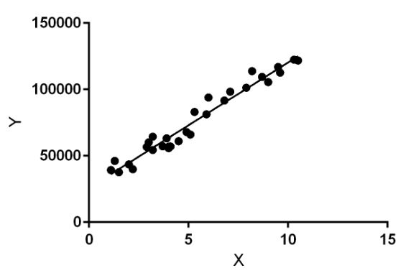
Linear Regression

Slide 8
Introduction
Health insurance or medical insurance is a type of insurance that covers the whole or a part of the risk of a person incurring medical expenses.
As with other types of insurance, risk is shared among many individuals.
By estimating the overall risk of health risk and health system expenses over the risk pool, an insurer can develop a routine finance structure, such as a monthly premium or payroll tax, to provide the money to pay for the health care benefits specified in the insurance agreement.
The benefit is administered by a central organization, such as a government agency, private business, or not-for-profit entity.

Slide 9

Abstract
In the domains of computational and applied mathematics, soft computing, fuzzy logic, and machine learning (ML) are well-known research areas. ML is one of the computational intelligence aspects that may address diverse difficulties in a wide range of applications and systems when it comes to exploitation of historical data. Predicting medical insurance costs using ML approaches is still a problem in the healthcare industry that requires investigation and improvement. Using a series of machine learning algorithms, this study provides a computational intelligence approach for predicting healthcare insurance costs. The proposed research approach uses Linear Regression, Support Vector Regression, Ridge Regressor, Stochastic Gradient Boosting, XGBoost, Decision Tree, Random Forest Regressor, Multiple Linear Regression, and k-Nearest Neighbors

Slide 10
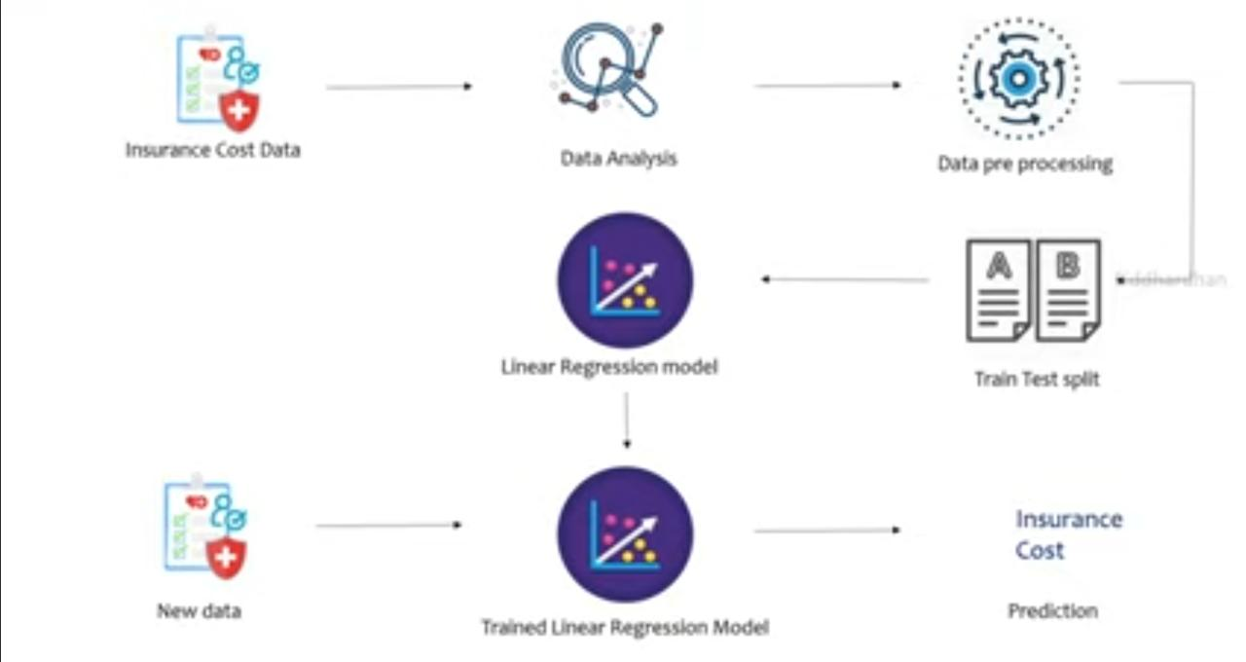
Work Flow

Slide 11
Conclusion
Background In this project, Linear regression model is evaluated for individual health insurance data. Various factors were used and their effect on the predicted amount was examined. It was observed that a person’s age and smoking status affect the prediction most in every algorithm applied.
Attributes that had no effect on the prediction were removed from the features. The effect of various independent variables on the premium amount was also checked. The attributes also in combination were checked for better accuracy results.
Premium amount prediction focuses on a person’s own health rather than other companies’ insurance terms and conditions. The models can be applied to the data collected in the coming years to predict the premium.
This can help not only people but also insurance companies to work in tandem for better and more health-centric insurance amounts.

Slide 12
Thank You

